Slide 1

COMPANY PROFILE

Slide 2
1
Retail Ambient Media Agency
About Us
A Vast Footprint Spanning 500+ Cites and 30,000+ Stores
At Sab Marcom, we specialize in retail marketing, helping brands connect with people in meaningful and impactful ways. We bridge the gap between businesses and their audiences through innovative advertising strategies that drive engagement, build brand loyalty, and boost sales. Our expertise lies in crafting highly targeted, data-driven marketing campaigns that blend creativity with strategy. Whether it's in-store promotions, digital advertising, experiential marketing, or shopper engagement, we ensure that your brand not only reaches but resonates with your customers.
2
3
Dynamic Organization
Proficient Management
4
5
Leading Market Place
Exemplary Support

Slide 3

Mission
At Sab Marcom, our mission is to empower brands by creating impactful, people-centric marketing strategies that foster genuine connections. We strive to blend creativity, innovation, and data-driven insights to help brands engage, inspire, and convert their target audiences effectively in the retail space.
Retail Ambient Media Agency
Vision
To be the leading retail marketing agency that transforms how brands communicate with consumers-by making every interaction meaningful, memorable, and results-driven. We envision a world where brands don’t just advertise but connect deeply with people, shaping lasting relationships and driving long-term success.

Slide 4
SAB Marcom Assets
SOH/OOH/DOOH
BTL/ATL/MICE/SIS
Retail Ambient Marketing
Brand Alliances/
Sponsorships/
Collaborations
Digital Marketing/ Influencers Marketing

Slide 5
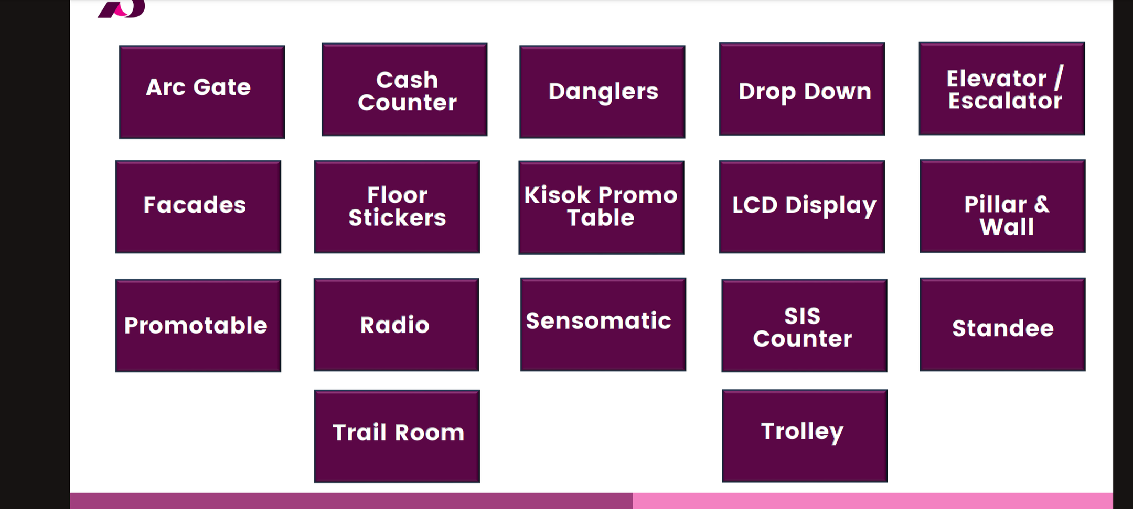
IN STORE BRANDING

Slide 6
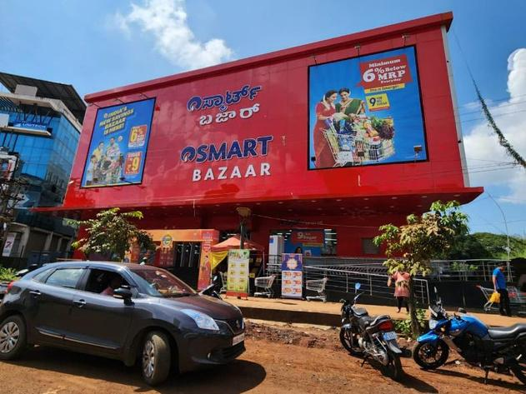
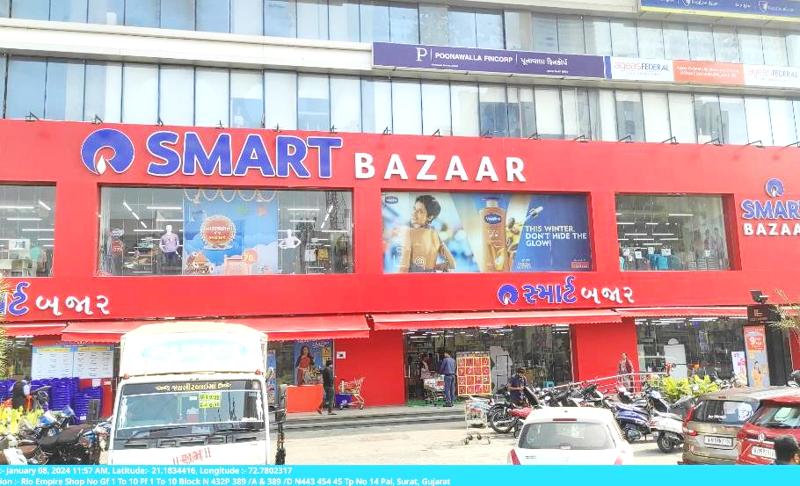
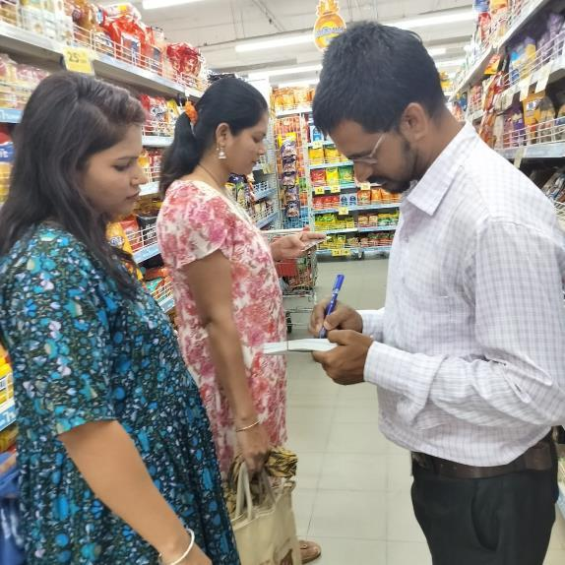
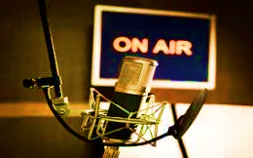
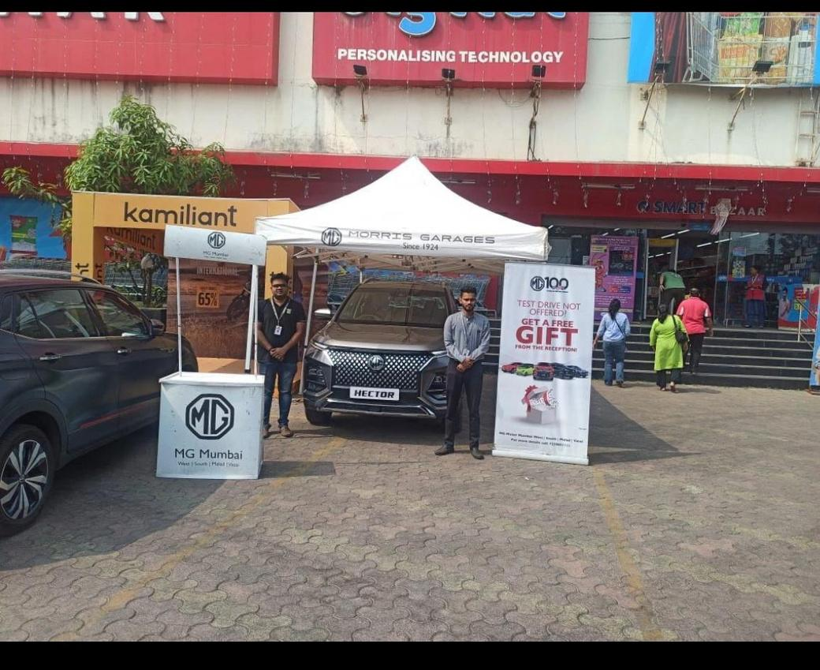
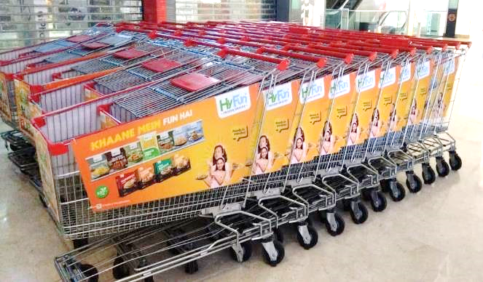
Store Hoardings
Glass Facade
Promoter Activity
In-store Radio
Podium Branding
Trolley Branding

Slide 7
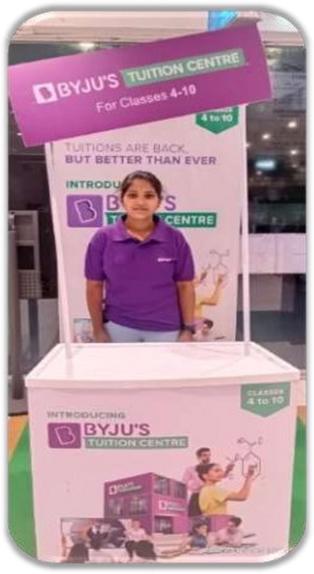
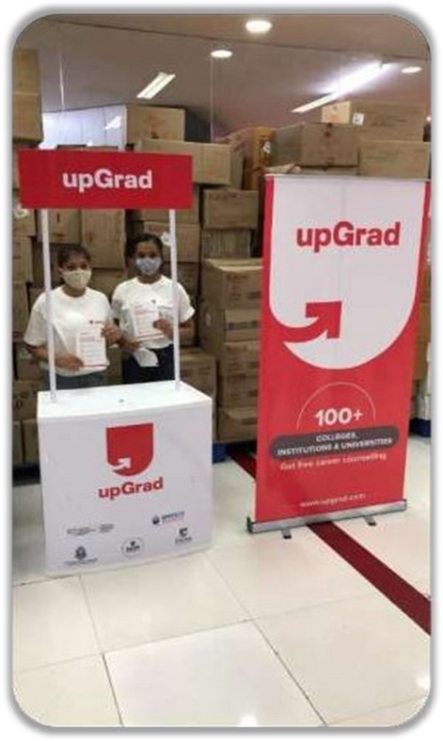
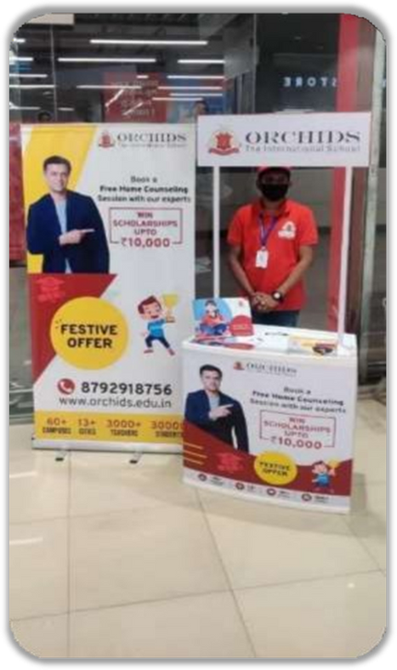
Promo Table (Kiosk)

Slide 8
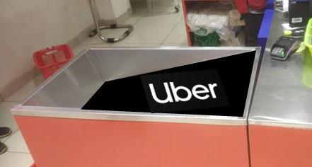
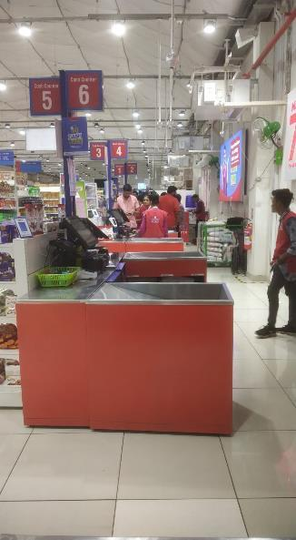
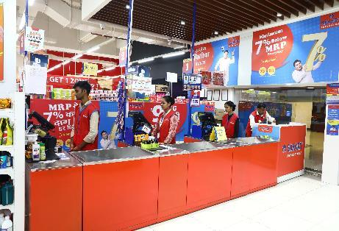
Point of Payment
Encouraging impulse buying at the check out counters
Place your brand here on side or top panels

Slide 9
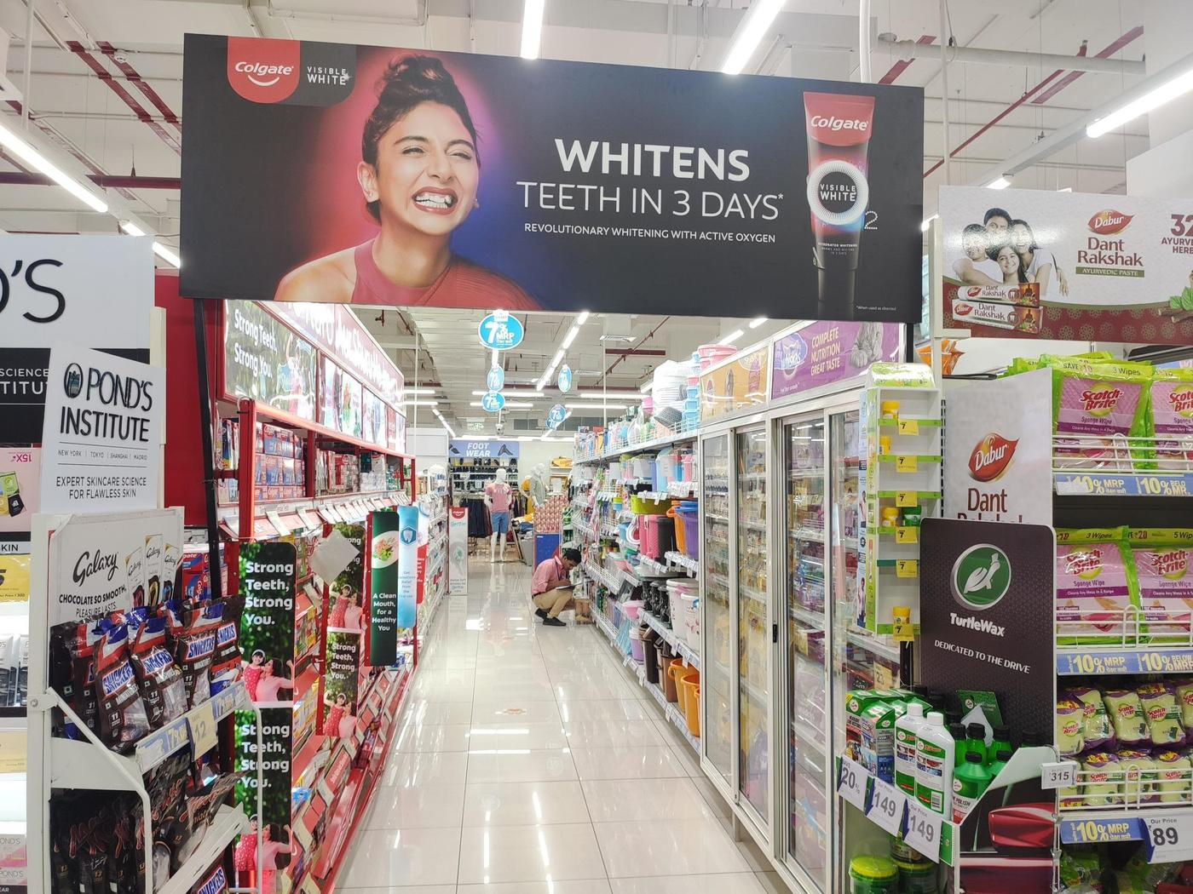
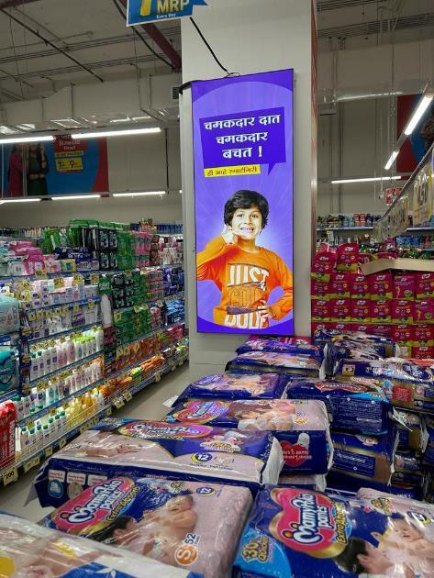
Category Arch Gate
Pillar Branding

Slide 10
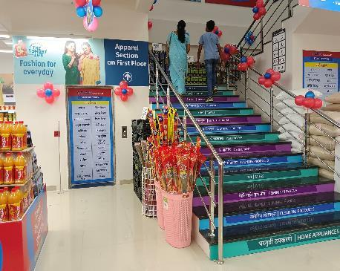
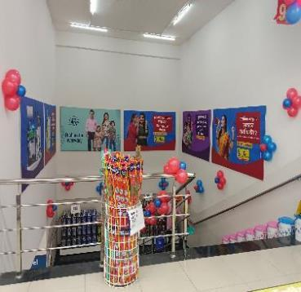
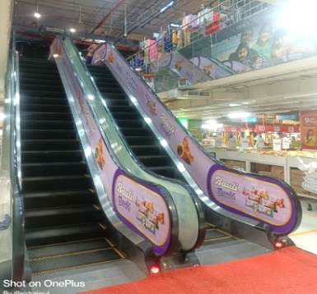
Inside Store
Staircase Branding
Walkway Branding
Passage Branding

Slide 11
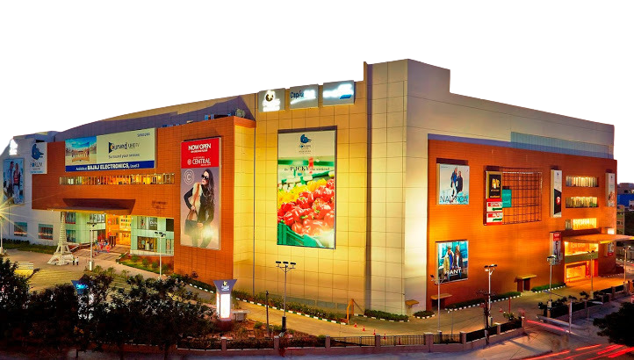
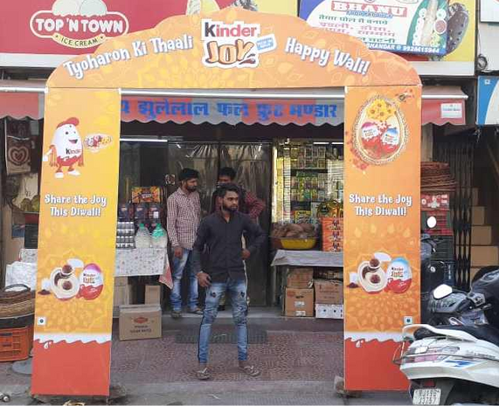
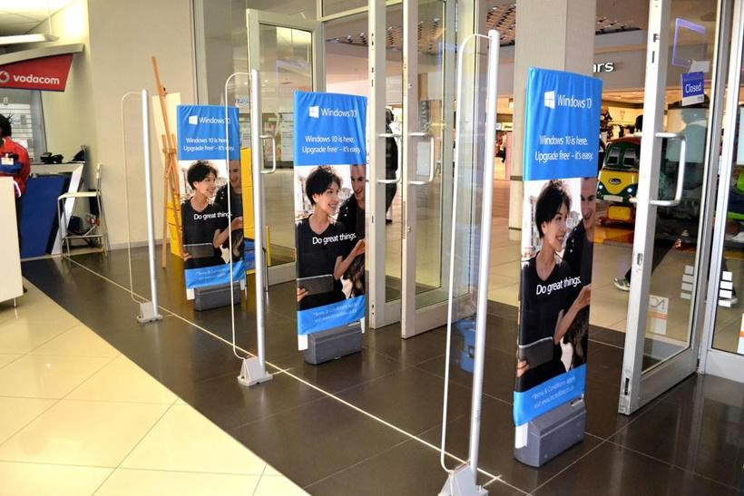
Fascade
Branding
Arch Gate
Branding
Sensometric
Branding

Slide 12
OOH & DOOH Brandings
Hoardings / Billboards
Tempo Activity
Tricycle Activity
Look Walker
Train External
Inside Panel Branding
Fuel Dispenser Branding
ATM Branding
Customer Engagement Activity
Hoardings & Standee Branding

Slide 13
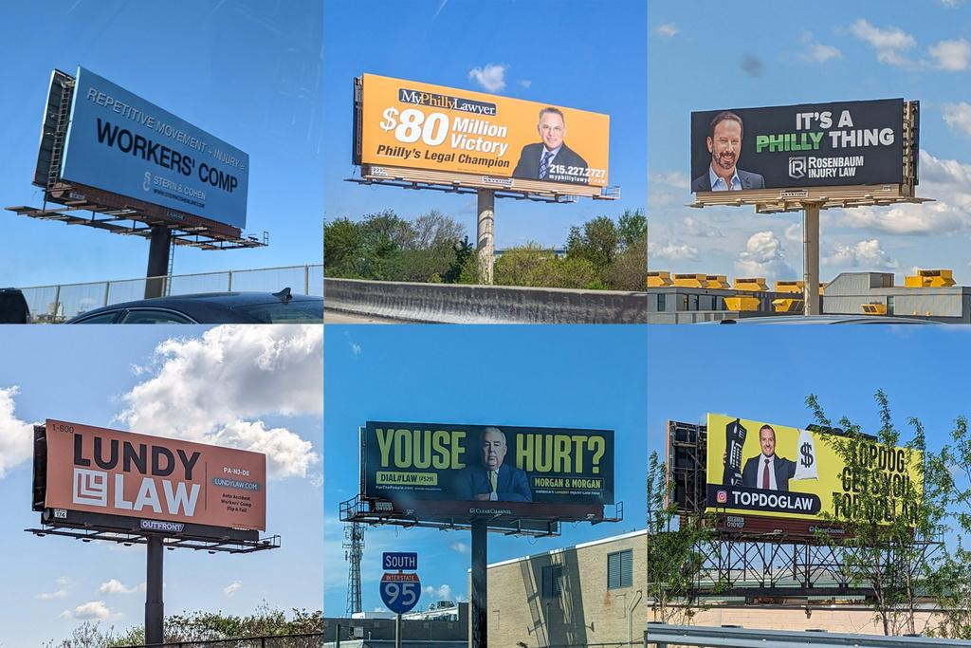
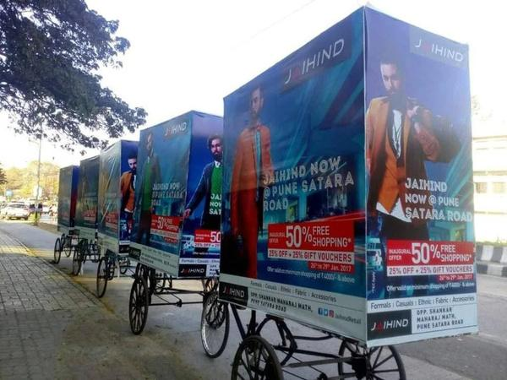
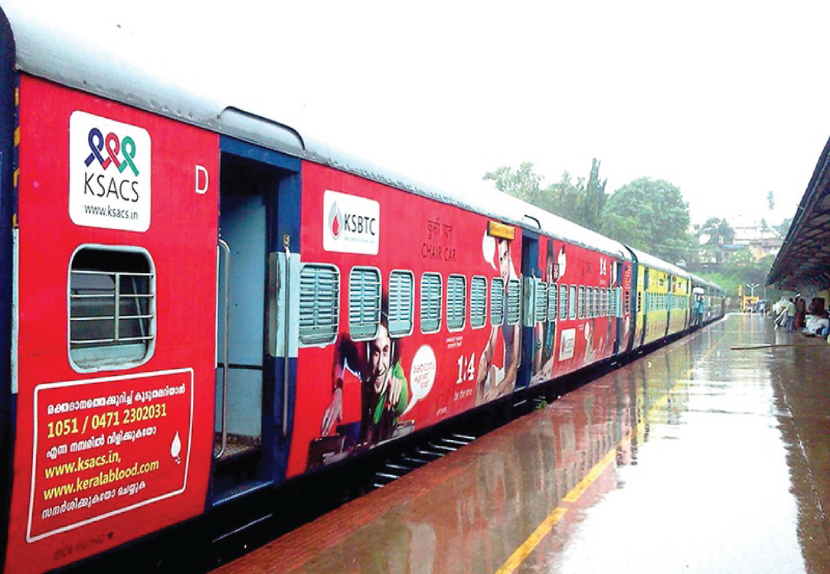
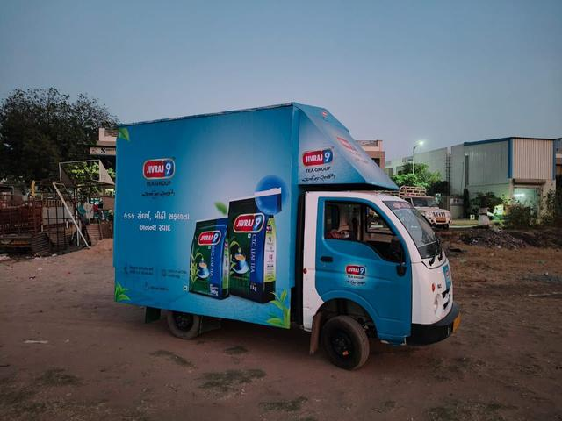
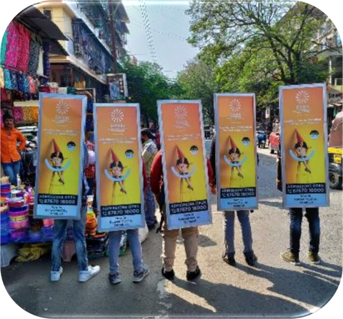
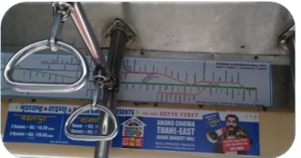
BillBoards
Tricycle Activity
Train Branding
Tempo Activity
Look Walker
Activity
Inside Panel Branding

Slide 14
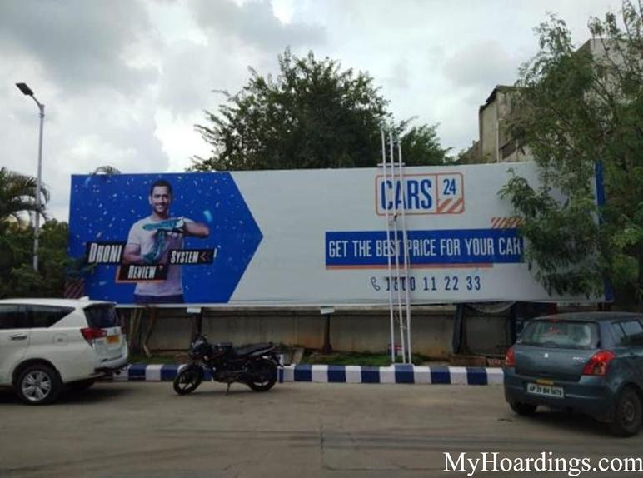
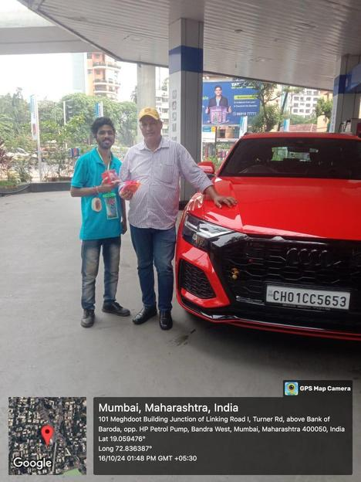
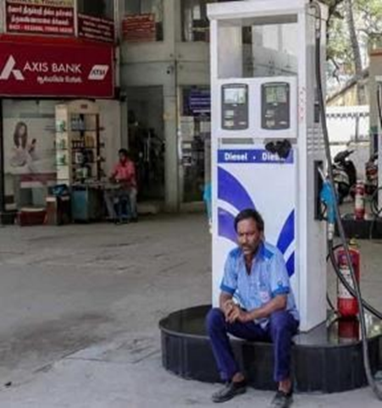
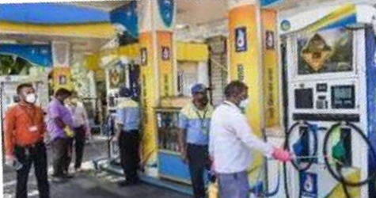
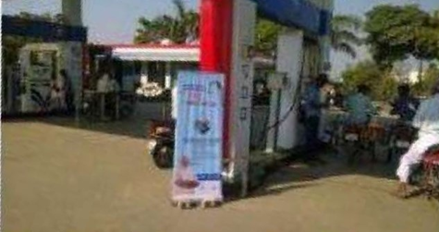
Bill Boards at Fuel Pumps
Engagement
ATM Branding
Fuel Dispenser Branding
Standee Placement

Slide 15
DIGITAL SERVICES
EVENT TIE-UPS
Meta Ads
Influencer Marketing
WhatsApp Marketing
Awareness Campaigns
Celebs & artist collabs
Social Media Management
Customized Set-Up Fabrication Units.
Sound System, Video Shooting, Theme Decore & Lights.
Content Creation
Visual merchandising
Awards & Gala Night

Slide 16
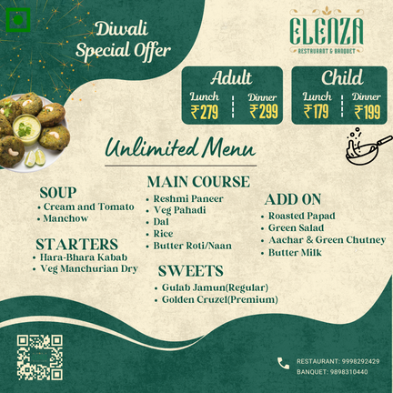
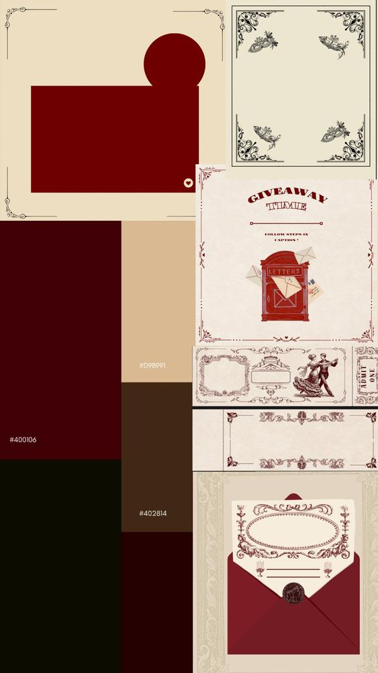

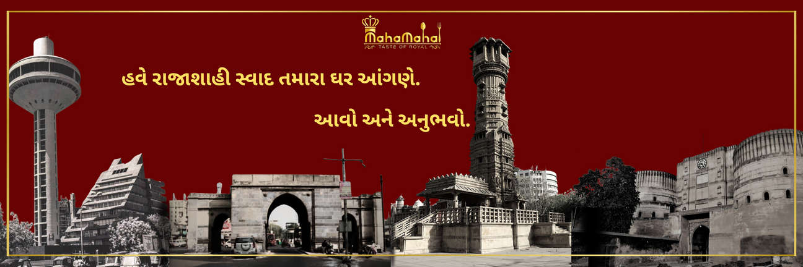
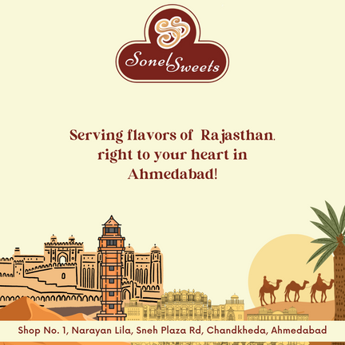
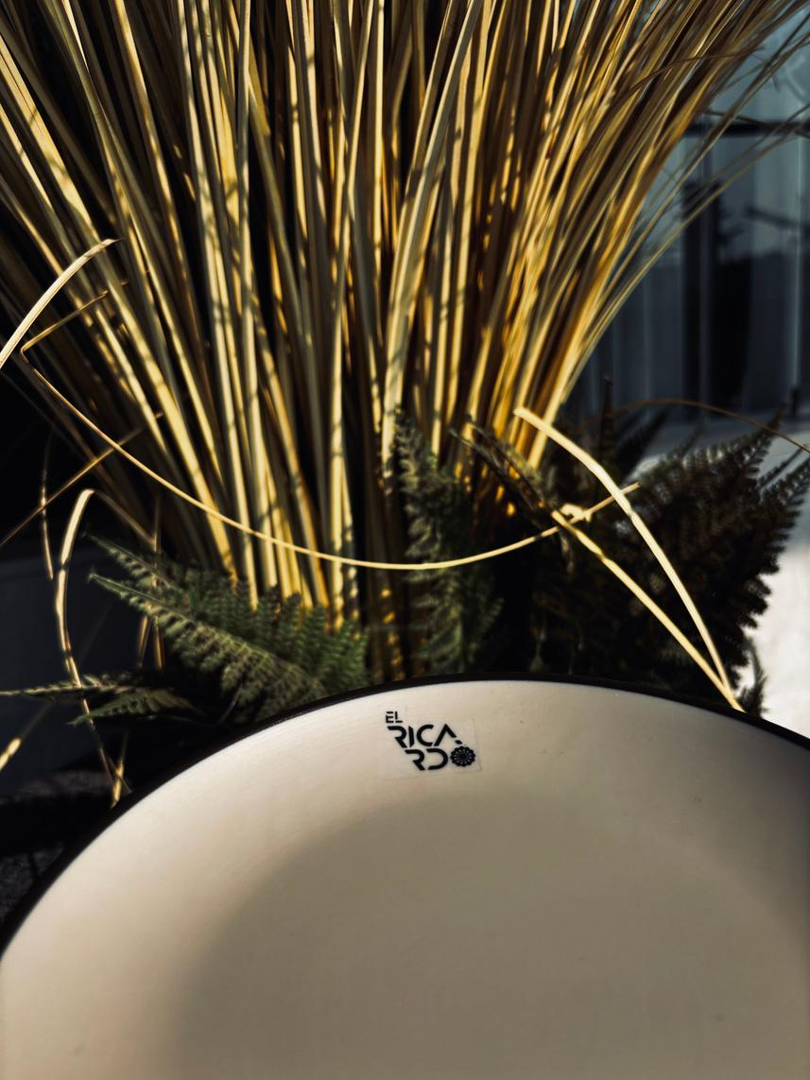
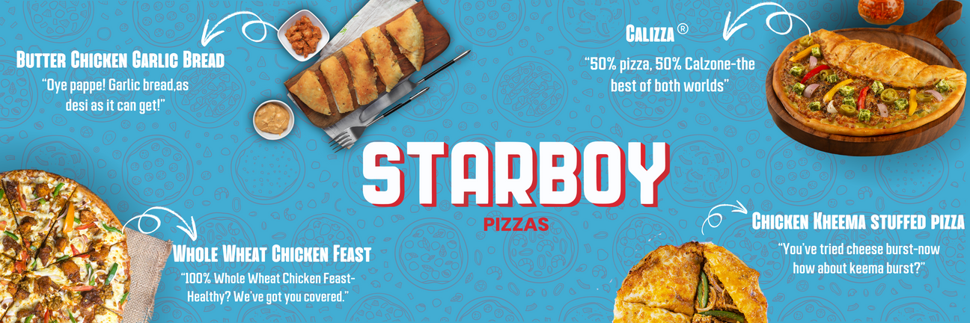
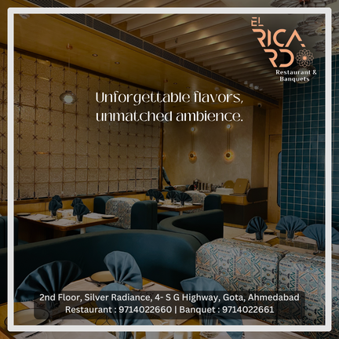
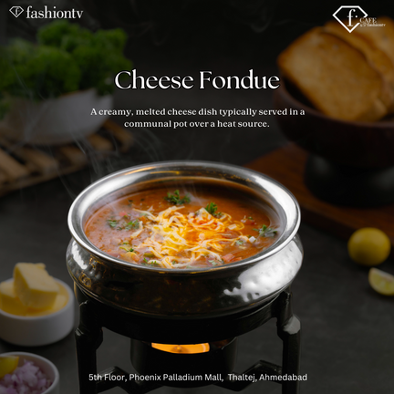
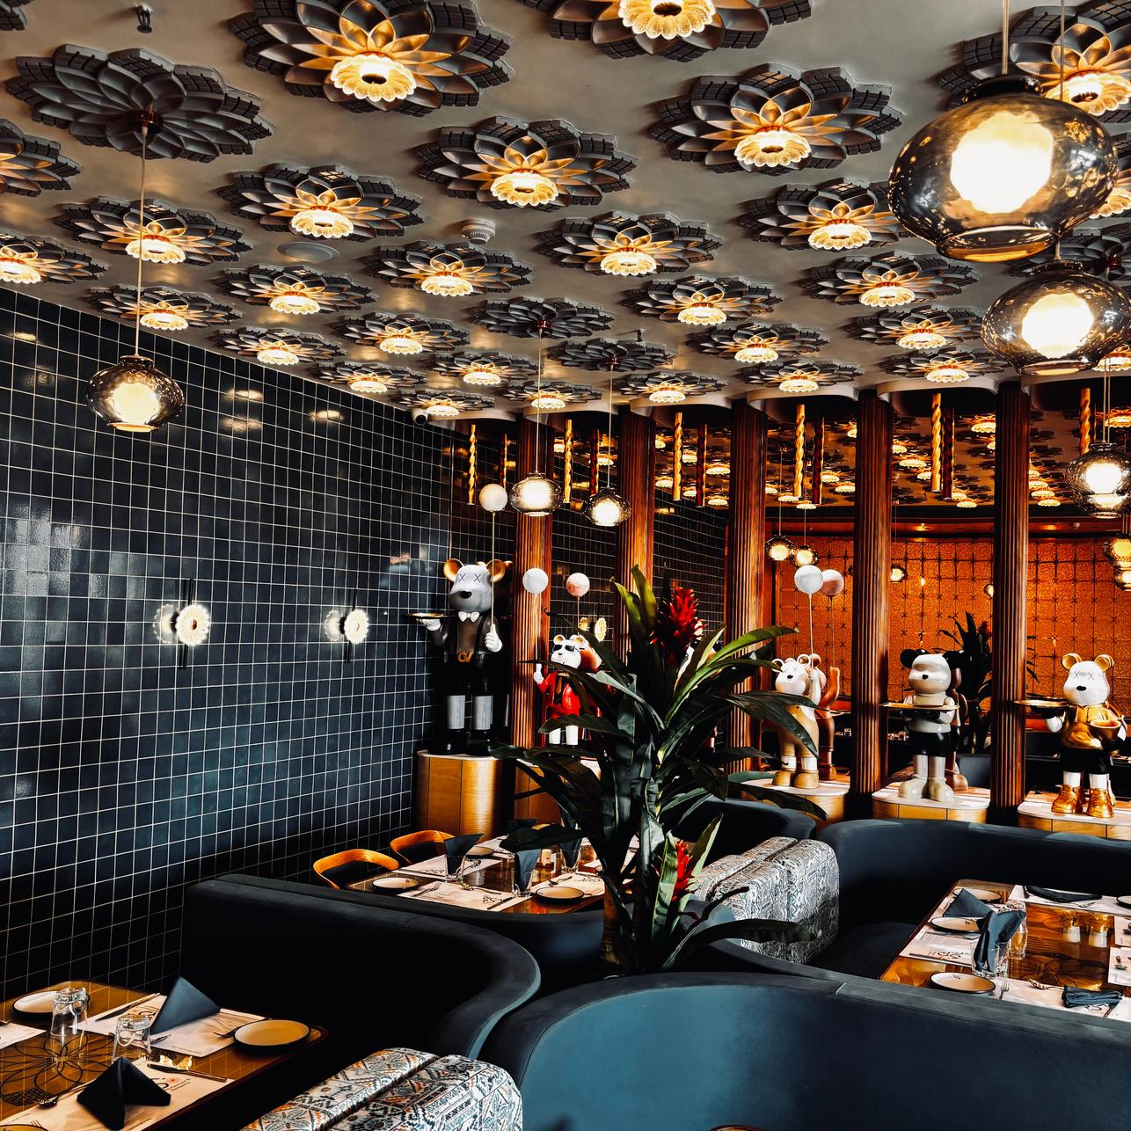
Recent Designs / Shoots

Slide 17
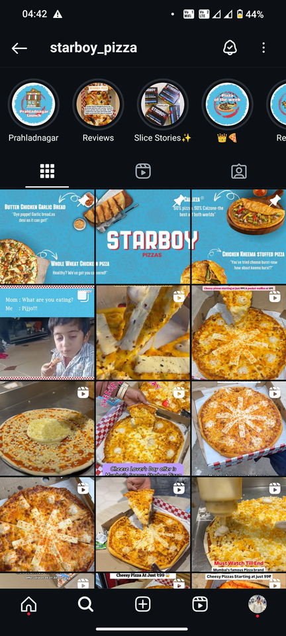
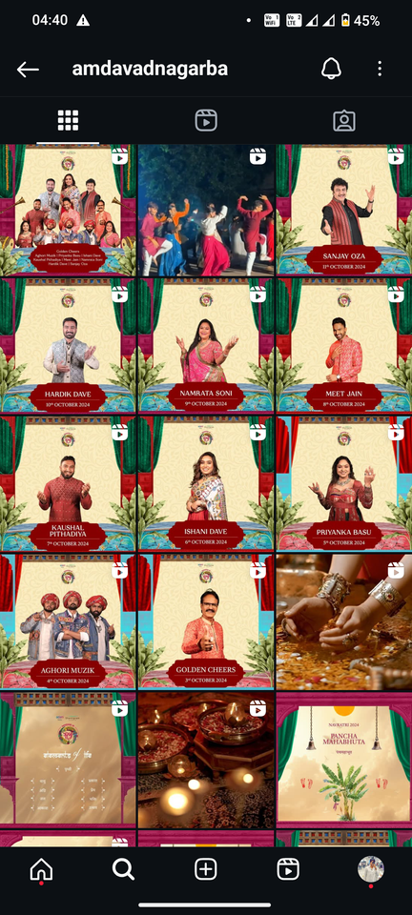
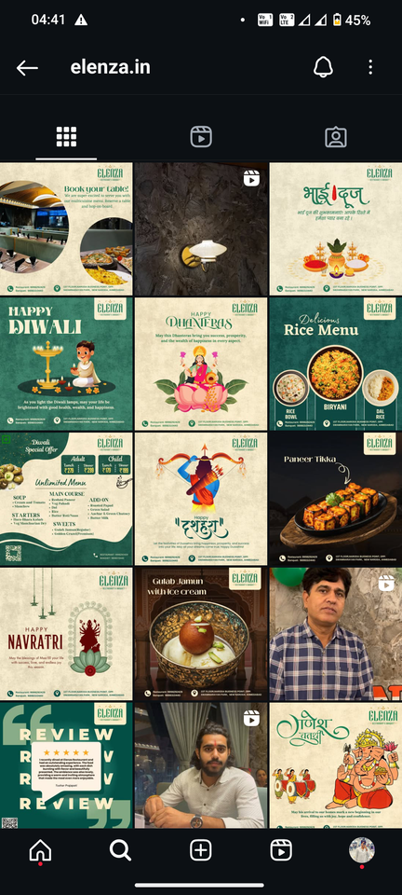
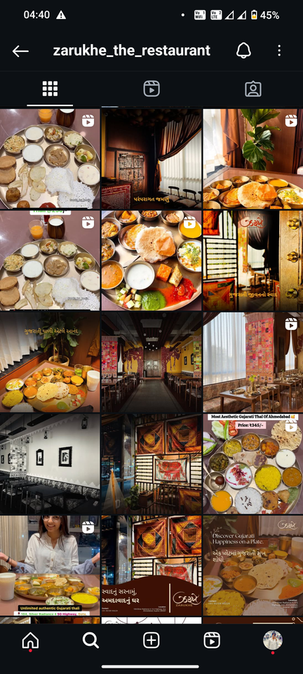
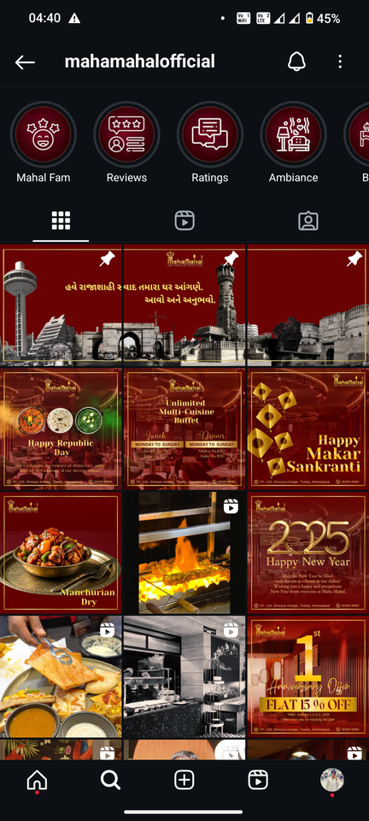
Previous Work Ex.
@starboy_pizza
@amdavadnagarba
@elenza.in
@zarukhe_the_restaurant
@mahamahalofficial

Slide 18
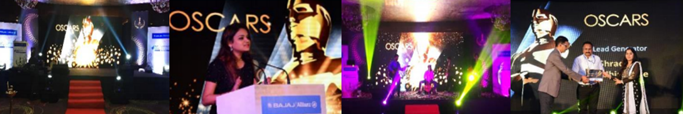
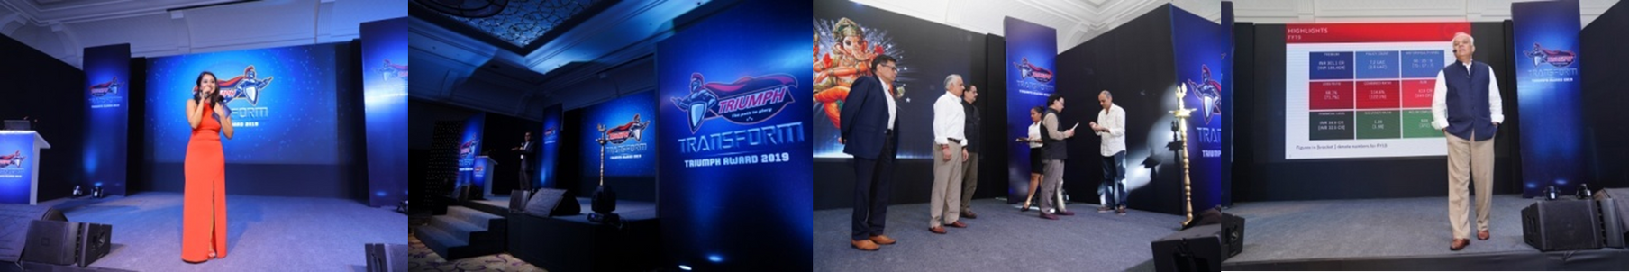
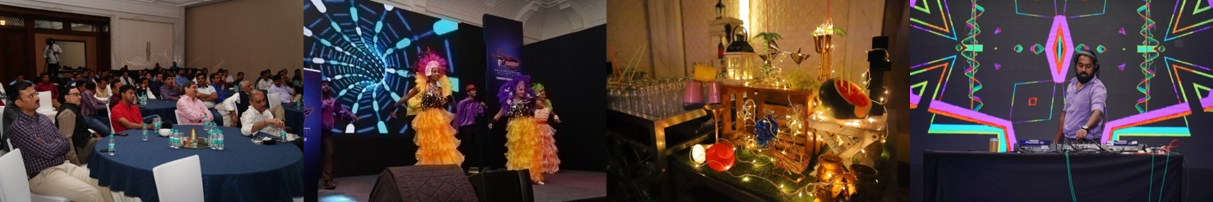
Previous Work Ex.

Slide 19
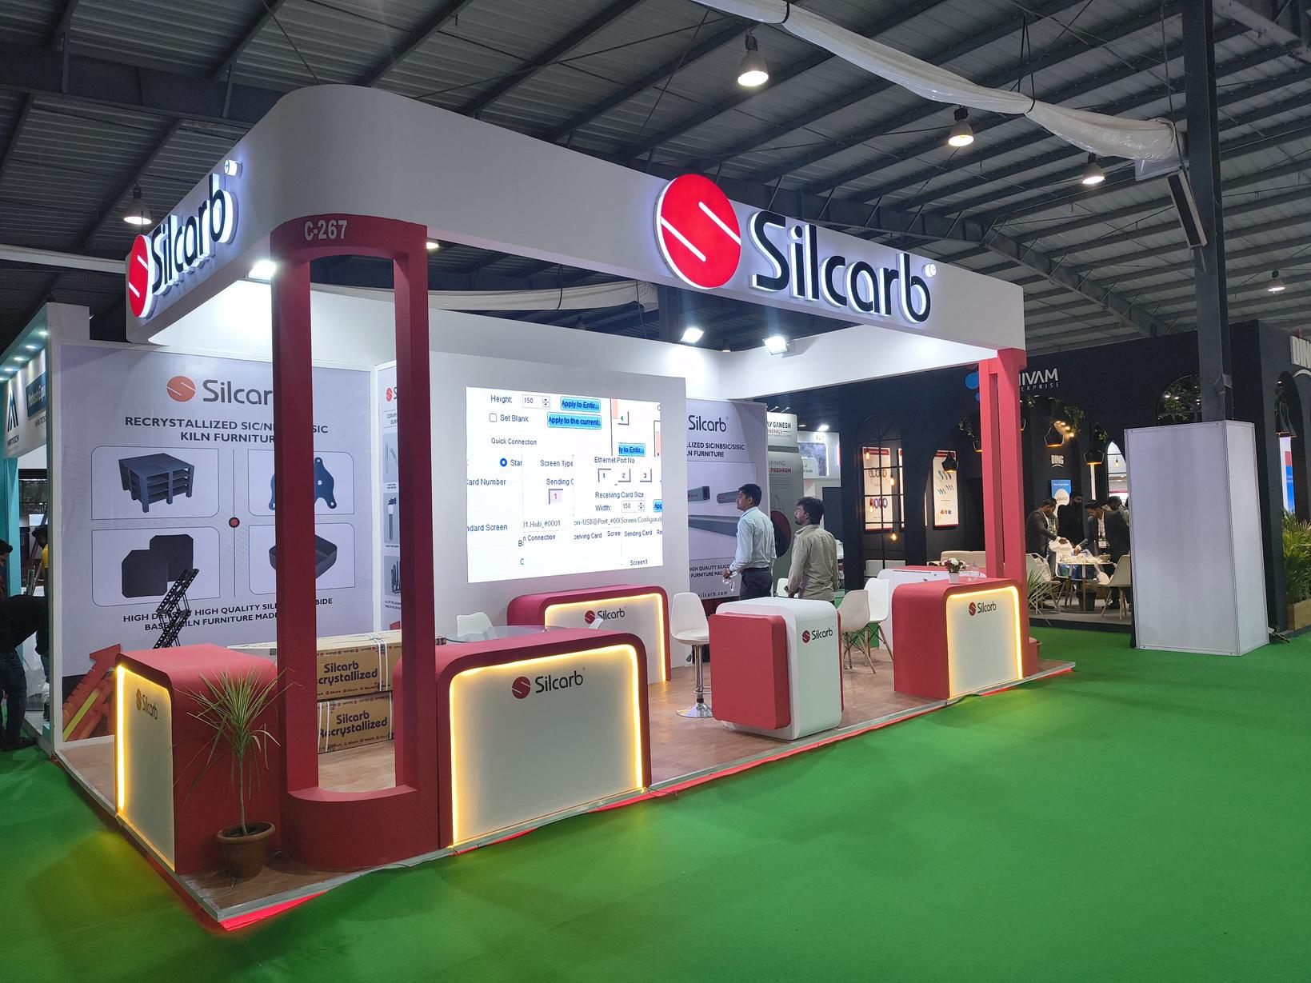

Exhibition Stall Design & Installations

Slide 20




FABRICATION
LIGHTS AND SOUND
VIDEOGRAPHY
ARTIST MANAGEMENT

Slide 21




































Our format partners

Slide 22



















Our brand partners

Slide 23


Thank You!
DHIRAJ CHABBRIA
Director - Marketing
: dc@sabmarcom.com
: +91 98700 79884

